Slide 1


v
Uniting Europe's Energy, Today
Reflections on the support needs identified
Tomasz Karpiński EnC Secretariat
June 2026

Slide 2
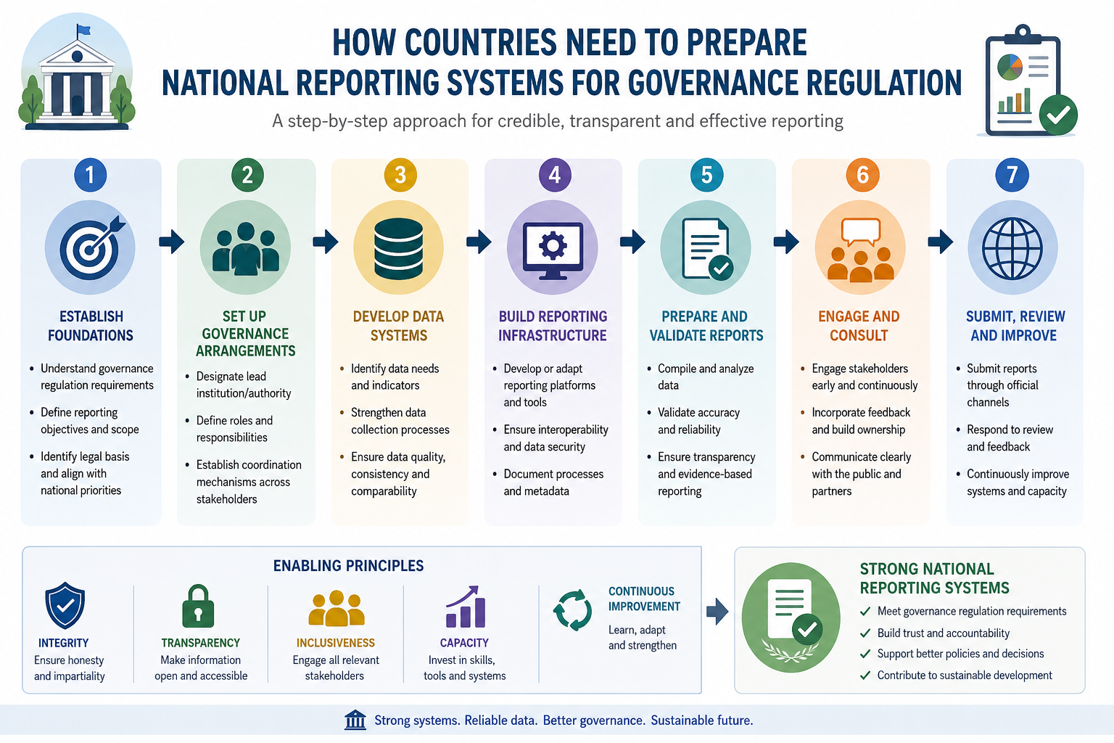

Slide 3
Challanges:
Capacity:
Lack of adequate national institutional capacity:
division of responsibilities
inter-institutional cooperation
Limited number of experienced national experts both on technical (implementation) and legal (transposition) level.
High dependence on external, ad-hoc support.
Coordination of donors.
Excessive workload and busy schedule:
Various international obligation implemented on the national level:
UNFCCC – NDCs, BTRs, LTS, adaptation communications
EnC – NECPs, NECP IPR, Governance Reporting + other climate legislation
EU - Accession process, Reform Agendas, EU ETS/carbon pricing/CBAM
Political or decision making level:
Lack of awareness of the scale of the technical challenge
Low priority given to climate issues
Lack of financial resources to allocate
Uniting Europe's Energy, Today
2

Slide 4
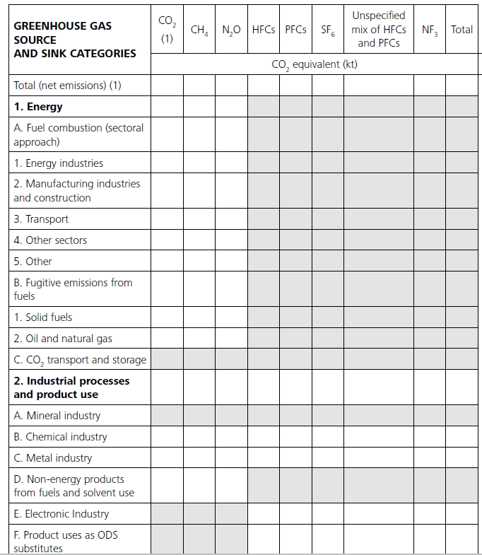
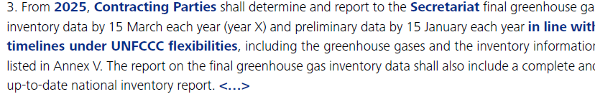
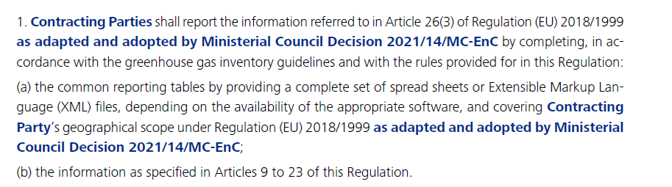
Main blocker – practical implementation
Timeline and deadlines:
Scope and methodology:
National Reporting Systems:
Structure:
Identification of source of the data
National institutions involved
Allocation of duties and responsibilities
Processes
Approval and submissions
Resources:
Human resources
Trainings
Financial resources / Budgets

Slide 5
Support:
EEA + EnC Secretariat
Provision and customization of reporting platforms and tools.
Support for the identification of existing statistical databases (EUROSTAT energy balances) or synergies with other reporting systems (Biennial Transparency Reports under UNFCCC)
User onboarding and EU Login support.
Technical assistance and troubleshooting to facilitate seamless reporting.
Technical
Capacity Building
Webinars for reporting streams
Technical workshops and trainings
In-depth practical training on real data
Individual in country visits or in EEA headquarters
Cooperation with other international support facilities (CBIT)
Initial checks
Uniting Europe's Energy, Today
4

Slide 6
Next steps:
Gradually expanding traditional capacity-building support toward more advanced analysis of submitted data:
High level political awarness
Annual Implementation Report (focus on transposition, implementation, deadlines)
Coordination Group for the Governance Regulation
Secretariat’s assessment of the 2024 NECPs and 2025 NECPRs
Preparation for the NECPs 2030-2040
2027 Comprehensive Review of GHG inventories
We continue to provide informal technical support, such as reviewing draft legislation, discussing specific reporting requirements, and identifying examples and best practices from the EU, etc.
Your comments from today's workshop are valuable input for planning future activities.
Uniting Europe's Energy, Today
5

Slide 7




THANK YOU!
energy-community.org
Energy Community Secretariat
Am Hof 4, Level 5, 1010 Vienna, Austria

